Slide 1
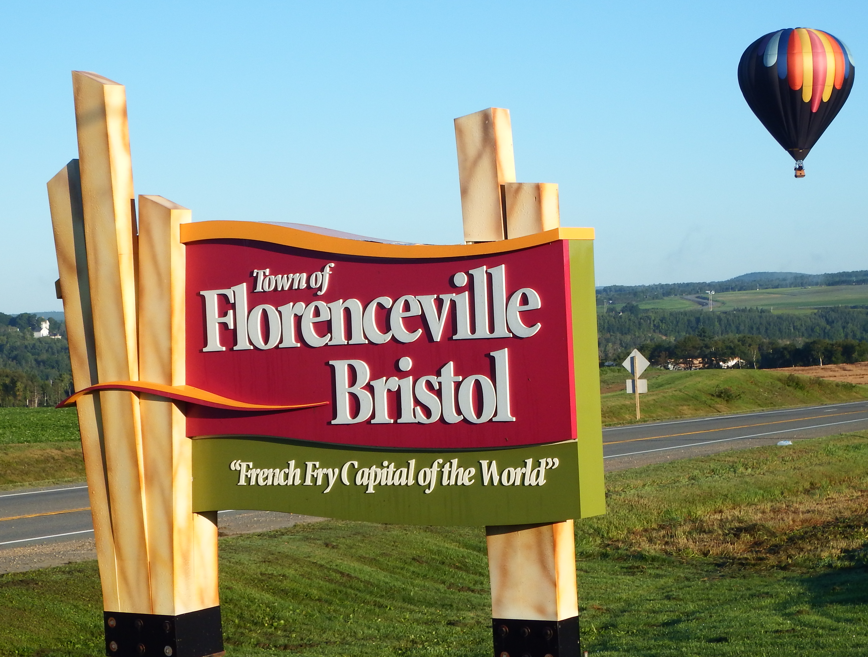
Council Orientation
2021

Slide 2

Getting ready to represent your Town
Advice on what to say and not
A Council is focused on direction/future of the community
Your principal role is on representing residents from your Ward
Expected to serve if asked (be on committees, attend events, etc.)
Mayor attends events if available
Deputy Mayor is called as backup if Mayor not available
Report any issues/concerns to CAO

Slide 3
Understanding the basics
Swearing in process
Council Meeting Process
Access to Town Hall
Parking
Photos
Town Email accounts
Using Town Letterhead/Symbols

Slide 4
Council meeting timeline
Council package contents and timing
Council preparation time
Regular meeting time and normal length
Closed session directly after Open session
Emailing minutes for approval and distribution
Emails (and occasional phone calls) as required through the month
Additional Special Meetings or Stakeholder Meetings as required
Receive by Friday prior to meeting
Plan on an hour to review everything
Normally done by 8:30 or 9 p.m.
Often finish between 9:30-10 p.m.
Sent day following meeting
Time required varies depending on number of projects happening
Time required varies

Slide 5
Procedural By-law
Council must follow the rules of procedure for Regular Council Meetings to ensure the efficient flow of business and accurately record what takes place. The Town’s By-Law Respecting the Procedures of the Council includes procedures for:
Conduct at Meetings
Public Participation at Meetings
Election of Deputy Mayor
Voting
Committees
In matters of procedure not provided for in the By-Law, Council is governed by “Roberts Rules of Order”. There are some copies of “Roberts Rules of Order” located in Council Chambers if a Councillor wishes to become familiar with meeting procedures.

Slide 6
Types of Meetings
Regular Council Meetings (RCM) – 2nd Tuesday of each month at 7 p.m.
  Must have quorum (majority of Council members = 4)
  Meetings are open to the public and advertised
Closed Sessions – immediately following an RCM as needed
  Meetings not open to public
  Only specific topics are permitted in Closed (see next slide)
  All decisions must be made and ratified (motion carried) in RCM/Open meetings except for decisions related to procedural matters, directions to a staff member or directions to solicitor
Special Council Meetings – as needed between regular meeting dates
Public Hearings/Presentations – normally happen at scheduled RCM
Committee Meetings – relate to specific services
  Mayor selects which Councillors will serve on which committees
  May also include members of staff or public

Slide 7
Reasons for Closed Meetings
The categories under which issues can be discussed at a closed session are:
Confidential information protected by law
Personal information
Information that could cause financial loss or gain
Land transfers
Information that could violate the confidentiality of information obtained from other governments
Legal opinions, privileged information or advice provided to the municipality by a solicitor
Litigation or potential litigation affecting the municipality or any of its agencies
Access to or security of particular buildings, other structures or systems, including computer or communication system
Information gathered by police
Labour and employment matters

Slide 8
Committees & Boards
Andrew and Laura McCain Gallery (ALMAG) Board (monthly)
Andrew and Laura McCain Library Board (monthly)
Beautification Committee (as required)
Facilities and Maintenance Committee (as required)
Finance Committee (as required)
Human Resource Committee (as required)
Planning Advisory Committee (monthly as required)
Public Works and Utilities Committee (as required)
Recreation Committee (as required)
Tourism and Business Development Committee (as required)
Policing and Public Safety Committee (as required)

Slide 9
Council Meeting Agenda
The meeting’s agenda is simply a list of items for consideration during the meeting.
The agenda contributes to effective meetings so Councillors can consider matters in an orderly and expedient manner.
The agenda for the Regular Council Meeting is defined in the Procedural By-Law.
Any addition or change to the agenda can only be approved with a unanimous vote of Council when the request to approve the agenda is put forward at the beginning of the meeting.

Slide 10
Motions of council
The main purpose of a meeting is to see that ideas or items of business are proposed, considered and decided
A motion is a proposed action to address the issue
Motions can only be ratified at Regular Council Meetings (RCM)
Any motion put forward at a Closed Session can only be “Motions to Recommend” to the RCM

Slide 11
making MOTIONS
Usually, the Mayor will read the motion and ask if anyone would like to make the motion.
If so, any Councillor can reply, “I make that motion” or “I will.”
If discussion has taken place and it is time to decide on a motion, any Councillor can propose a motion. (example: I move to allow Peddlers to set up on Town property.)
Once a motion is on the floor, the Mayor will ask if anyone would like to second it.
Any Councillor can say, “I would second that motion.”
The Mayor will ask, “All those in favour?”
All Councillors in favour will respond, “Aye.”
If the Mayor does not hear a reply from everyone, he will ask, if any Councillor is contrary minded to which any Councillor can say, “Aye” if they are opposed to the motion.
The mover’s and seconder’s names will be recorded in the minutes
Any votes against a motion are recorded in the minutes

Slide 12
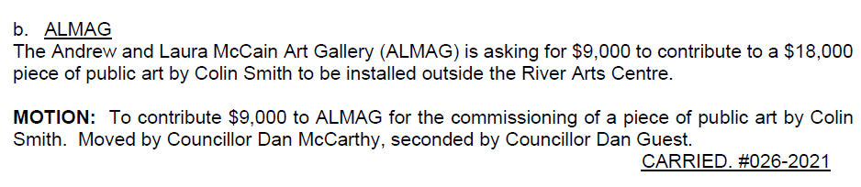
making MOTIONS (con’t)
This is an example of a motion in the minutes of the March 9, 2021 Council meeting:

Slide 13
Conflict of Interest
Part 8 of the Local Governance Act details what constitutes a conflict of interest.
At the start of every meeting members of Council and senior appointed officers should examine the agenda to ensure they do not take part in discussions or vote on a matter in which they may be in a conflict of interest.
If a Councillor sees they will have a conflict, they would state their conflict when that item is up for discussion, and would excuse themself from the meeting, returning when the next item is brought forward.

Slide 14
Mayor and Council
Roles and responsibilities
Mayor
Leader of Council
Chairs the Council meetings
Provides leadership and guidance to Council
Promotes a positive relationship with the Town Administration and outside organizations
Ensures the good governance, behaviour and ethics of Council
Attends social functions and ceremonies on behalf of the Town

Slide 15
Deputy Mayor
Acts in place of the Mayor (due to absence or inability of the Mayor)
Holds same powers as Mayor in their absence
Councillors
Must incorporate the interests of the whole municipality and its residents
Play a vital leadership role in creating and implementing Florenceville-Bristol’s vision, strategic direction and values.
As part of Council, Councillors guide the development of local policies, set service standards and priorities, and monitor the performance of the organization.
The New Brunswick Local Governance Act is the main piece of legislation governing the powers, responsibilities, and general operation of local governments.

Slide 16
Councillors’ key responsibilities
Strategic planning for the whole municipality and a sustainable future
Determining the financial strategy and allocating resources via the Town budget
Representing ratepayers and residents
Advocating on a broad range of issues
Liaising and coordinating with other levels of government, non-government, community groups and the private sector
Overseeing the management of community assets
Facilitating community participation
Managing an open and trusting relationship with Town Staff through the CAO

Slide 17
Council/Staff relationship
If the roles of Councillors and staff are not clearly understood, there is potential for conflict between elected Councillors and Municipal Staff
Council should have a clear understanding of what staff do, their responsibilities, and the limits of their authority
Council should also listen to advice from staff who normally have a long-term understanding of municipal policies and operations.
Council is responsible for making policy decisions while staff support the decision-making process and administer those policies.

Slide 18
Office staff support
The CAO is the key contact for Council
The CAO would determine which department or staff should be involved in a request and would relay the information accordingly
Typically, the staff would report back to the CAO with findings or confirmation that a request has been carried out.
For non-urgent issues, the manager would include updates to Council in their monthly reports.

Slide 19
Role of Senior Staff
The only employee of Council is the Chief Administrative Officer (CAO)
All other employees fall under the direction and leadership of the CAO
The primary role of senior staff is to support Council in their decisions
This includes implementing Council’s goals and strategies, managing the delivery of services and providing advice and support in the decision-making process

Slide 20
Town Departments & Offices
General Government Services
This department is responsible for the overall governance and financial administration of the Town
It includes:
  Council functions
  General administration
  Financial management
  Legal matters and compliance with legislation
  Grants for social and environmental purposes
  Civic relations

Slide 21
General Government Services (con’t)
Chief Administrative Officer (CAO)
The only employee of Council
Responsible for the overall administrative planning, coordination, and control of the activities and business affairs of the Town
Primary staff liaison with Council and is accountable for ensuring that decisions of Council are implemented by the organization
Leads, directs, and coordinates the Town’s operational departments
Through the leadership of the CAO, the Town’s operational departments will execute annual operational plans and manage the Town’s operational, capital and utility budgets in line with the policies and objectives established and approved by Council.
Responsible for the effective and efficient delivery of all services in compliance with all applicable By-Laws, policies, statutory requirements, and collective agreements.
Accountable for establishing performance expectations for staff and creating a positive working culture for employees.

Slide 22
General Government Services (con’t)
Clerk
As of 2021, the CAO is also the Town Clerk
Acts as the secretary to Council and attends all meetings, records the minutes, maintains all records of Council
Is the custodian of the corporate seal
Along with the Mayor, signs all agreements, contracts, deeds and other documents to which the Town is a party
The Assistant Clerk is currently the Administrative Services Manager, who acts as a backup and assistant to the Clerk.

Slide 23
General Government Services (con’t)
Finance Department
The Treasurer provides for the control, management and administration of the financial accounting and data processing functions
Includes planning, budgeting, accounting, sewer revenue, payroll and purchasing
Assists in keeping Council fully informed about all aspects of the Town’s finances and enables them to make sound financial judgements.
The 2021 property tax rate is $1.2899 per $100 of assessment.

Slide 24
Finance Department (CON’t)
Finance Department (Con’t)
Two different budgets: Utility and General
Within these, expenses are split into Operating and Capital expenses:
  Operating Budget: used to outline the Town’s estimated revenues and expenditures for a one-year period;
  Capital Budget: expenditures on equipment, buildings, and projects (such as road paving or sewer installations) which are expected to last more than one year and the general practice is to pay for capital projects and equipment over a period of years.
Department Heads begin preparations for their departmental budgets in September of each year. These draft budgets are discussed and finalized by the Finance Committee for presentation to Council at a Regular Council Meeting in November.

Slide 25
Protective Services
Includes policing protection, fire protection, emergency measures, animal control and other protective measures
Policing services contracted from RCMP, and are dispatched through the Woodstock office of the RCMP
The Fire Department provides rescue, fire suppression, and related activities to the public, as well as assisting with traffic control at many Town events throughout the year. It is a Volunteer Fire Department that includes of one Fire Chief and two Deputy Fire Chiefs. They respond to fire calls and other related emergency services for the Town and nearby Local Service Districts
The Emergency Measures Organization (EMO) is responsible for emergency planning
  Concerned with preparedness, damage mitigation, response, and recovery in the case of a major disaster
  Promotes emergency preparedness for all residents, organizations and businesses in the Town
  The Regional Emergency Action Plan provides Florenceville-Bristol, Bath and Centreville with a management tool to facilitate a timely, effective, efficient, and coordinated emergency response.

Slide 26
Transportation services
Includes common services
Road and streets maintenance (paving, patching, plowing, sanding,…)
Street lighting
Traffic services
Parking
Other transportation related functions
Carried out by the Public Works and Maintenance Department.

Slide 27
Environmental Health Services
This service includes waste collection and disposal
Curbside garbage collection is contracted with JS Bellis
Pickup is every Thursday
The Town pays extra to also have the garbage collected on recycling week
The Western Valley Regional Service Commission (WVRSC) contracts the solid waste disposal for Florenceville-Bristol
One cart was provided to each residence at no additional cost

Slide 28
Public Health Services
This category provides for maintenance of the Bristol Cemetery, which is owned by the Town
This maintenance is carried out by the Public Works and Maintenance Department
If the Town owned a medical or dental clinic, those would fall under this category too

Slide 29
Environmental Development Services
Environmental Planning & Zoning
WSP for any engineering needs
Hatchard Engineering for Building Inspection and Assistant Development Officer functions
These two firms provide technical knowledge to the CAO and Administrative Services Manager to assist with processing requests for Subdivision Plans, building permits, Zoning By-Law amendments, Municipal Plan By-Law amendments, and Unsightly Premises.
The CAO also performs the Development Officer functions.

Slide 30
Environmental Development Services (con’t)
Tourism and Business Development
In 2021, Council committed to a heightened focus on the tourism economy
Responsible for leading, initiating and collaborating with multiple stakeholders such as the business community, provincial government, public and interest groups to build strong partnerships and programs in the delivery of quality initiatives for the purpose of expanding the tourism and business economies of the community.
Conducts market research and oversees the creation and implementation of a competitive marketing strategy as the basis for coordinating and overseeing the design and administration of marketing programs and events

Slide 31
Recreation and cultural services
Includes the maintenance and operation of recreational and cultural facilities, including:
  Swimming pool
  Arena
  Parks and playgrounds
  Other recreational and cultural facilities.
Maintenance of those facilities is provided by the Public Works and Maintenance Department.

Slide 32
Recreation and cultural services (con’t)
Recreation Department
Provides meaningful, innovative, accessible, and sustainable recreation and leisure opportunities for the enjoyment of visitors and residents, assisting in building community spirit and individual wellbeing.
Effective management of parks, playgrounds, facilities, open spaces, direct program delivery and community development initiatives.
Indirectly, the department provides assistance to community groups and organizations through leadership development, partnerships, community consultation and resource coordination.

Slide 33
Recreation and cultural services (con’t)
Andrew & Laura McCain Library and Andrew & Laura McCain Art Gallery
Both housed in a municipal-owned building.
The Library’s operational expenses are paid for by the municipality, but it is staffed with provincial employees. They have something for all ages, including activities and workshops.
The Andrew & Laura McCain Art Gallery is also housed in the basement of the same building. The Town provides the space free of charge as well as covers building expenses. ALMAG boasts the best of New Brunswick visual arts in the St. John River Valley.

Slide 34
Wastewater Systems
Sewer services
Includes the maintenance and operation of the underground networks, treatment plants and lagoons
Property owners are billed in March and September
The Residential rate in 2021 is $155.70 per home/apartment unit billed twice per year
Commercial rates are the same, with number of units billed being dependent on the type of business

Slide 35
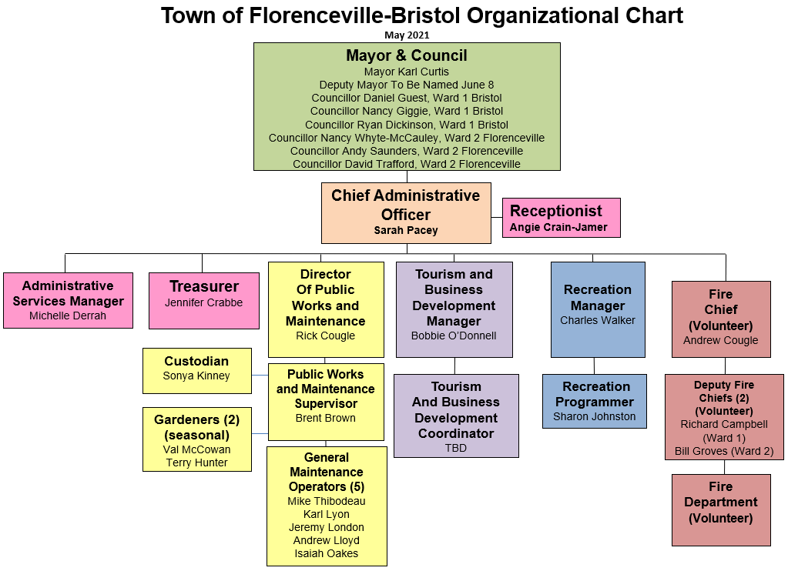

Slide 36
GOOD Governance
Governance is the process of decision-making and the process by which decisions are implemented. Good governance is defined by how government conducts itself in its interaction with other stakeholders and emphasizes:
Values and ethics
Effective Council-staff relations
Public engagement and opportunities for partnerships
Long-term strategic and sustainability planning, identification of priorities and performance measurement
Ongoing review of municipal service delivery and performance management
Identifying and managing risk

Slide 37
COUNCIL’s LEVERS of Power
Strategic Plan/Priority Setting
Budget Approval
By-laws
Policies
Motions/Resolutions
Directing CAO

Slide 38
Strategic plan
The 2017 Plan defined the Vision for Florenceville-Bristol as:
Florenceville-Bristol is a welcoming, service-oriented, safe, fun and sustainable community where municipal services are planned and delivered in a responsive, professional, efficient manner and where all of its residents enjoy a high quality of community life.
The Key Strategic Issues in the plan were established as:
  Tourism and Business Development
  Infrastructure
  Finance
  Human Resources
  Recreation
  Community
Council and CAO will work together to update the Strategic Plan for the next four years.

Slide 39
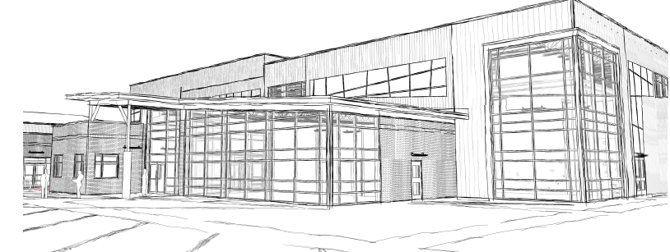
Council projects
Recreation Centre Addition Announcement and Build ($9.3 million)

Slide 41
Amsterdam Inn Hotel – opening July/August 2021
Strip Mall Renovation of Pharmacy – complete June 2021
Medical Clinic/Professional Building
Primary Health Care Recruitment
Tourism Strategy Project – iImagine on retainer until end of August 2021
  AMR’s and additional projects
  Plans for owning “French Fry Capital of the World”
  Plans for Communities of Interest
  Plans for mentoring Tourism businesses and other businesses
  Incentives for businesses
  Tourism website
RCMP/Policing - Discussions with RCMP about coverage and alternate approaches
NB Trail usage by ATVs and dirt bikes
Old Florenceville Bridge – Lobbying Province to fix it and open it

Slide 42
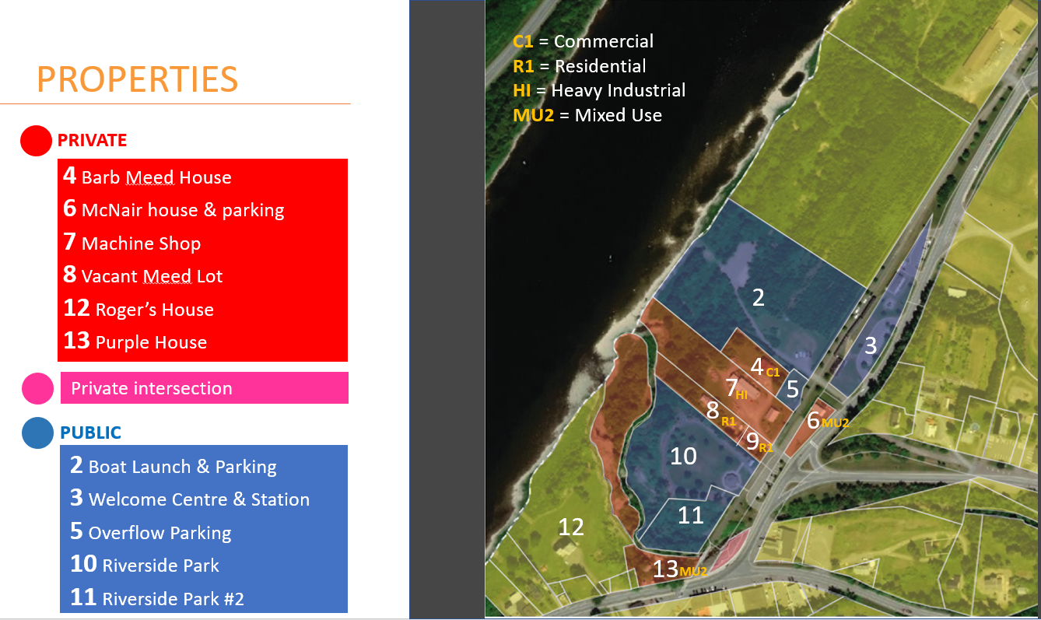
Review of the Riverside Park/Shogomoc Spatial Zone

Slide 43
Multi-use Path From Town Boundary To Town Boundary Along The River

Slide 45
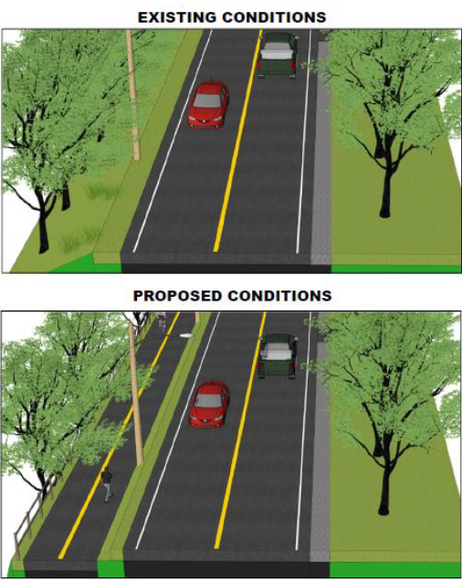
Multi-use Path From Town Boundary To Town Boundary Along The River

Slide 47
Preliminary engineering for multi-use path on West side of river (Jim Davis Dr, Centreville Rd, Riverview Dr, Perkins Way) – on hold until we determine plan for Old Florenceville Bridge
Active Transportation Plan - on hold until we determine fate of Old Florenceville Bridge
Investigation into new trail developments in Town – West side along river, more trail at Shiktehawk Trail and Sam’s Park, addition of trail at CNHS
Atlantic Garden Home – research into locations and development for affordable housing
Main St Paver Replacement
New Outdoor Pool
Public Art (Colin Smith piece at River Art Centre, old photographs at Community Hall, poem at Community Hall river overlook, etc.)
High speed in Town (Rogers/Xplornet combination)

Slide 48
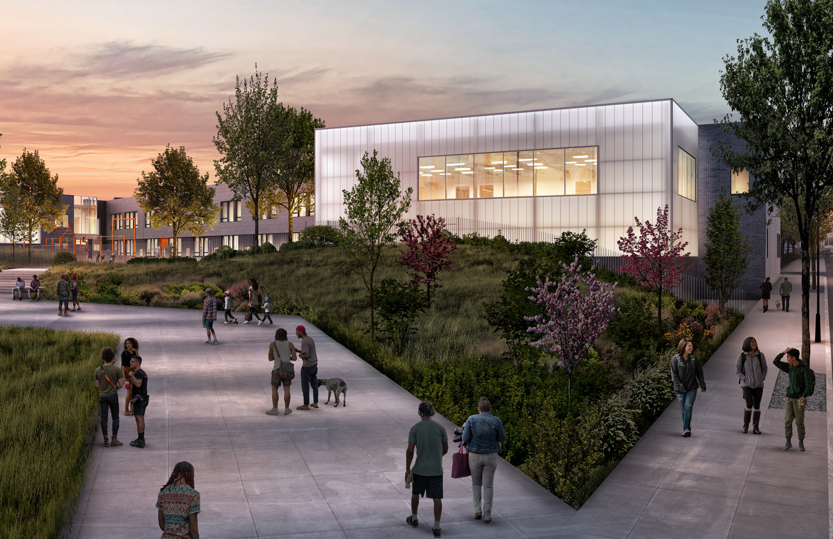
K-8 School recommendation - #6 on Province’s list
  Learning Campus
  Classrooms
  Rooms for music, art, science and technology, resource/special care, guidance
  Project work areas
  Cafeteria or cafetorium
  Community Kitchen
  Library / media centre
  Two gymnasiums
  Community room
  Multi-purpose rooms
  Early-childhood learning space
  Theatre / Performance space

Slide 49
Beautification (grants for residents/businesses and additional flower beds and props)
Boardwalk Flood Damage Repairs
Roadway Upgrading Projects – Maple St
Municipal Reform
Carleton North Rural Community – put on hold since Provincial Municipal Reform
Municipal Natural Asset Initiative Natural Asset Management Plan
Quest Smart Energy Community Accelerator – launched April 2021
EV charging stations – coming spring 2021
Eco-Action Project with World Wildlife Fund
Groundwater Study (to determine water availability)
Dr Clay Marco Development on Main St
Regional Resiliency Team

Slide 50
Council compensation
By-law No. 2 The Composition of the Council and the Remuneration of the Mayor and the Councillors
Paid in May and November for previous six months of service
  Mayor $11,444.40
  Deputy Mayor $7,594.92
  Councillors $5,722.20
Human Resources Committee review prior to an election
Last reviewed March 2021
Reimbursed for any travel expenses incurred while completing their duties outside Florenceville-Bristol.

